Slide 1


Slide 2

LAUNCHING THE NEW ADDRESS
SEASON 2

Slide 3
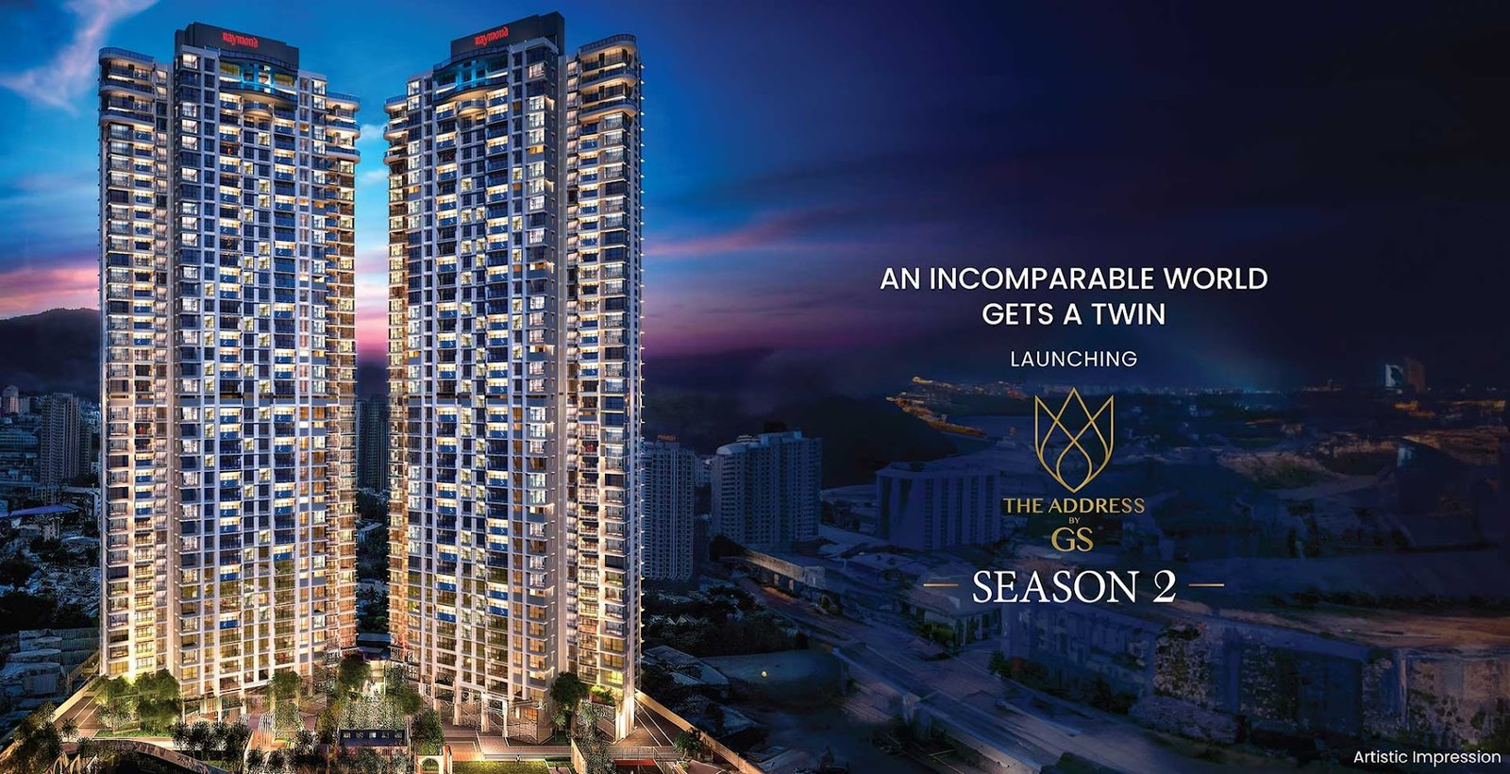

Slide 4
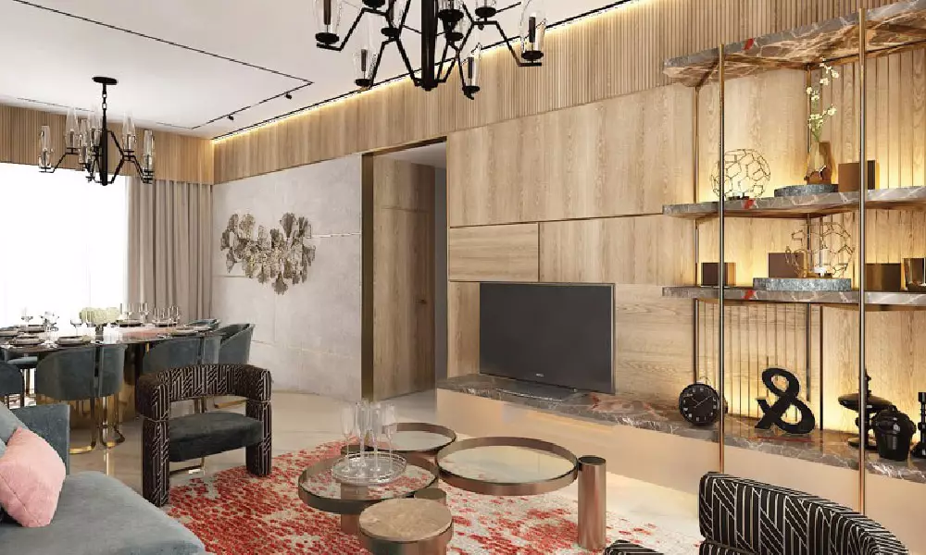
INSPIRED BY THE ROYAL ROMAN LIFE

Slide 5
PROJECT UNIQUE SELLING PROPOSITION
Bare – Shell Flat (1st time in Thane).
Low Density.
Easy Connectivity from Thane Station, Upcoming Metro Line 4, Cadbury Junction etc…
With in distance of 2 min school, Malls, Hospital, Metro Station etc...
High Street Shopping eg. Korum Mall, Viviana Mall etc…
Near by Hospital Advantage eg. Bethany Hospital, Jupiter Hopsital.
Near by Road & Highways are Eastern Express Highway, Pokhran Road 1 & 2, Mumbai- Nashik Highway.

Slide 6
KEY FEATURES
3,4,5 & 6 Bed Premium Apartments.
Pokhran Road 1-- 4 Premium Towers in the 6 Acres.
Carpet Area Start From 991 sq.ft.
40 Habitable Floors.
3 Flats Per Floor with 6 Elevators.
10% Due & Possession- Dec 27.
RERA Possession- Dec 28.
Pokhran Road 1-- 4 Premium Towers in the 6 Acres.
Inspired by the Royal Roman Life.

Slide 7
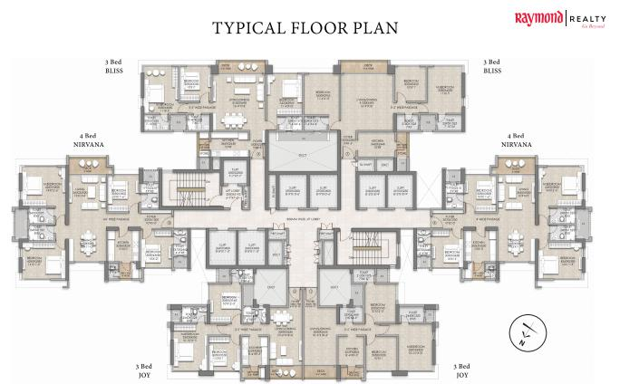

Slide 8
CONFIGURATION
TOWER C – 1
3 BHK (JOY) Carpet Area 991 sqft (Price – 2.43 CR).
3 BHK (BLISS) Carpet Area 1177 sqft (Price – 2.86 CR).
3 BHK (NIRVANA) Carpet Area 1530 sqft (Price – 3.76 CR).

Slide 9
CONFIGURATION
TOWER C – 2
4BHK + Servent room with Balconies--
4 BHK (STELLER) Carpet Area 2432 sqft (Price – 5.89 CR).
4 BHK (SKY SUITE) Carpet Area 2597 sqft (Price – 6.04 CR).
4 BHK (EPITOME) Carpet Area 2744 sqft (Price – 6.51 CR).

Slide 10
AMENITIES
Clubhouse
Swimming Pool
Kids Play area
Highstreet Retail
Landscape Garden
Jogging Track
Pet Park
Gym
Multipurpose Hall
Athletic Court
Closed Car Parking

Slide 11
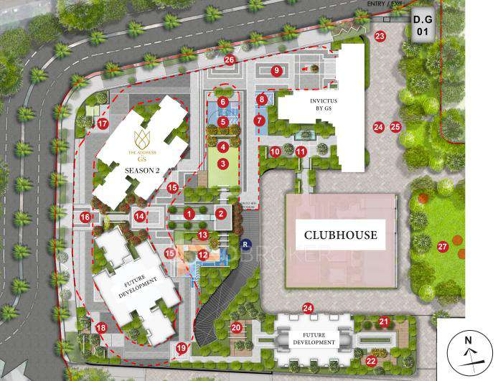
SITE
PLAN

Slide 12
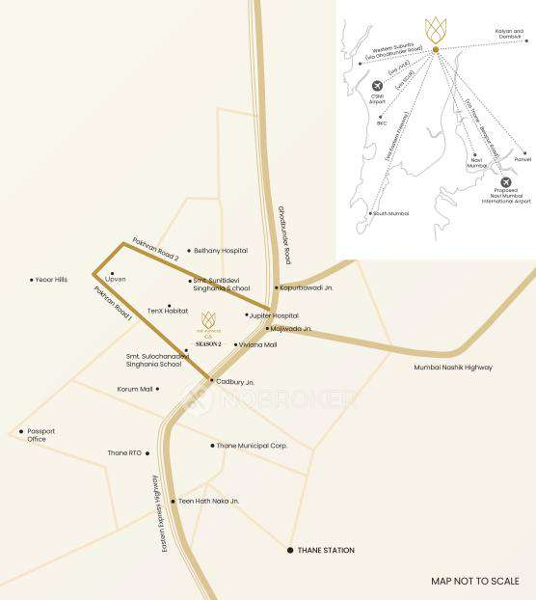
LOCATION
PLAN

Slide 13
HOW TO CONVINCE (RTMI CLIENT) IN TO UNDER CONSTRUCTION PROPERTY
Choice of Inventory.
Chain of Agreement.
Good Negotiation Scope.
Flexible Payment Plan.
WC (Water Closet).

Slide 14
THANK YOU FOR WATCHING

